Slide 1

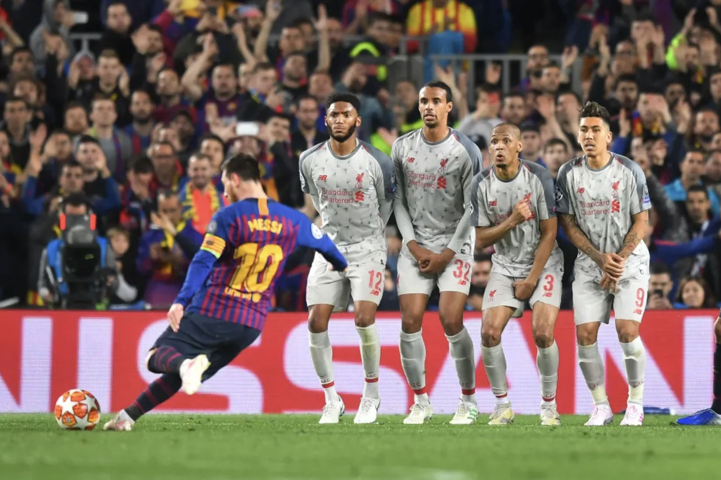

DATA SCIENCE PROJECT
ANALYSIS OF FOOTBALL MATCHES
Lionel Messi scores a free-kick against Liverpool in 2019. Photo by Michael Regan. Source: Getty Images

Slide 2

CONTENT
01
MOTIVATION
02
OUR RESEARCH QUESTION
03
ABOUT THE DATA
04
VISUALIZATION, INTERPRETATION & SIGNIFICANCE
05
CONCLUTIONS & DISCUSSION
06
ASSUMPTIONS & LIMITATIONS
07
NEXT UP

Slide 3
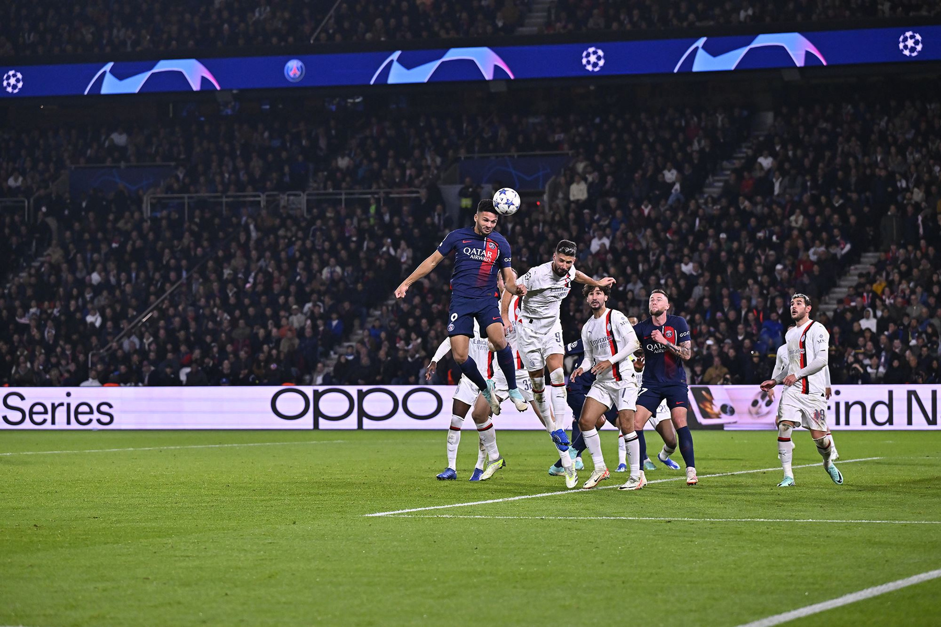



MOTIVATION
Our motivation to work on the football dataset came from our love for the sport and because it has a global fan base.
Football data can be used to answer a variety of questions about the sport. This includes questions about player performance, team strategy, and the overall dynamics of the game.
PSG Win over Milan - PSG Official Website - https://en.psg.fr

Slide 4

OUR RESEARCH QUESTION
Primary: Does having more left-footers affect the outcome of football matches in the English Premier League?
Secondary: Do other physical properties of (a) player/s affect the outcome of a match?
Height of players (min/max/avg)
Weight of players (min/max/avg)
Null Hypothesis - The number of left-footed players does not impact the outcome of the match

Slide 5


Pappalardo, L., Cintia, P., Rossi, A. et al. A public data set of spatio-temporal match events in soccer competitions. Sci Data 6, 236 (2019). https://doi.org/10.1038/s41597-019-0247-7
ABOUT THE DATA
The data was from publicly available (spatio-temporal) football data (study published in Nature, Scientific Data) which has metrics from the top five European matches and the World Cup.

Slide 6

ABOUT THE DATA
~40 M
The data was arranged as Matches, Events, and Individual data.
In Complex nested JSON and CSV files
Datapoints

Slide 7





ABOUT THE DATA
Matches
Events
Indivdual
each match Included season, teams, players for each team, their match highlights, referees details etc.
Spatiotemporal data including passes, throw-ins, free kicks etc.
Details about players, coaches, referees, teams etc.

Slide 8

01
02
03
EXTRACT
CLEAN
ANALYSE
Data had to be manually extracted as it was in the form of complex nested JSON and CSV files. Special considerations were needed as some data was not collected in some countries and tournaments
Somewhat clean. We needed to consider some “0” values and “null” (str) values.
Analysis was done in python with the help of specific libraries.
Notes:
EXTRACTING
CLEANING
--Some Value types needed to be converted.
--Null Values, 0 Values had to be analysed so that it represented the correct meaning.
ANALYSING
--Like Matplotlib, Seaborn, scipy,

Slide 9
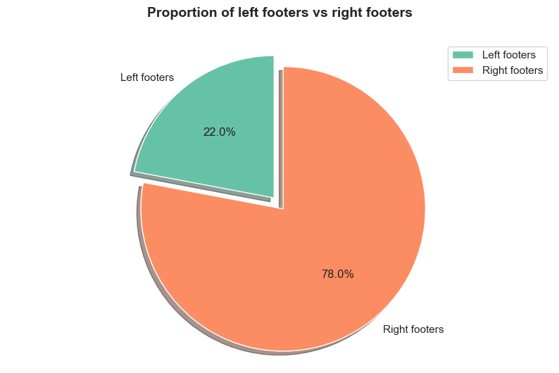
VISUALIZATION
Fig: Footedness of the players in the tournament (England)
Notes:
Left - 22% - 130
Right - 78% - 460

Slide 10
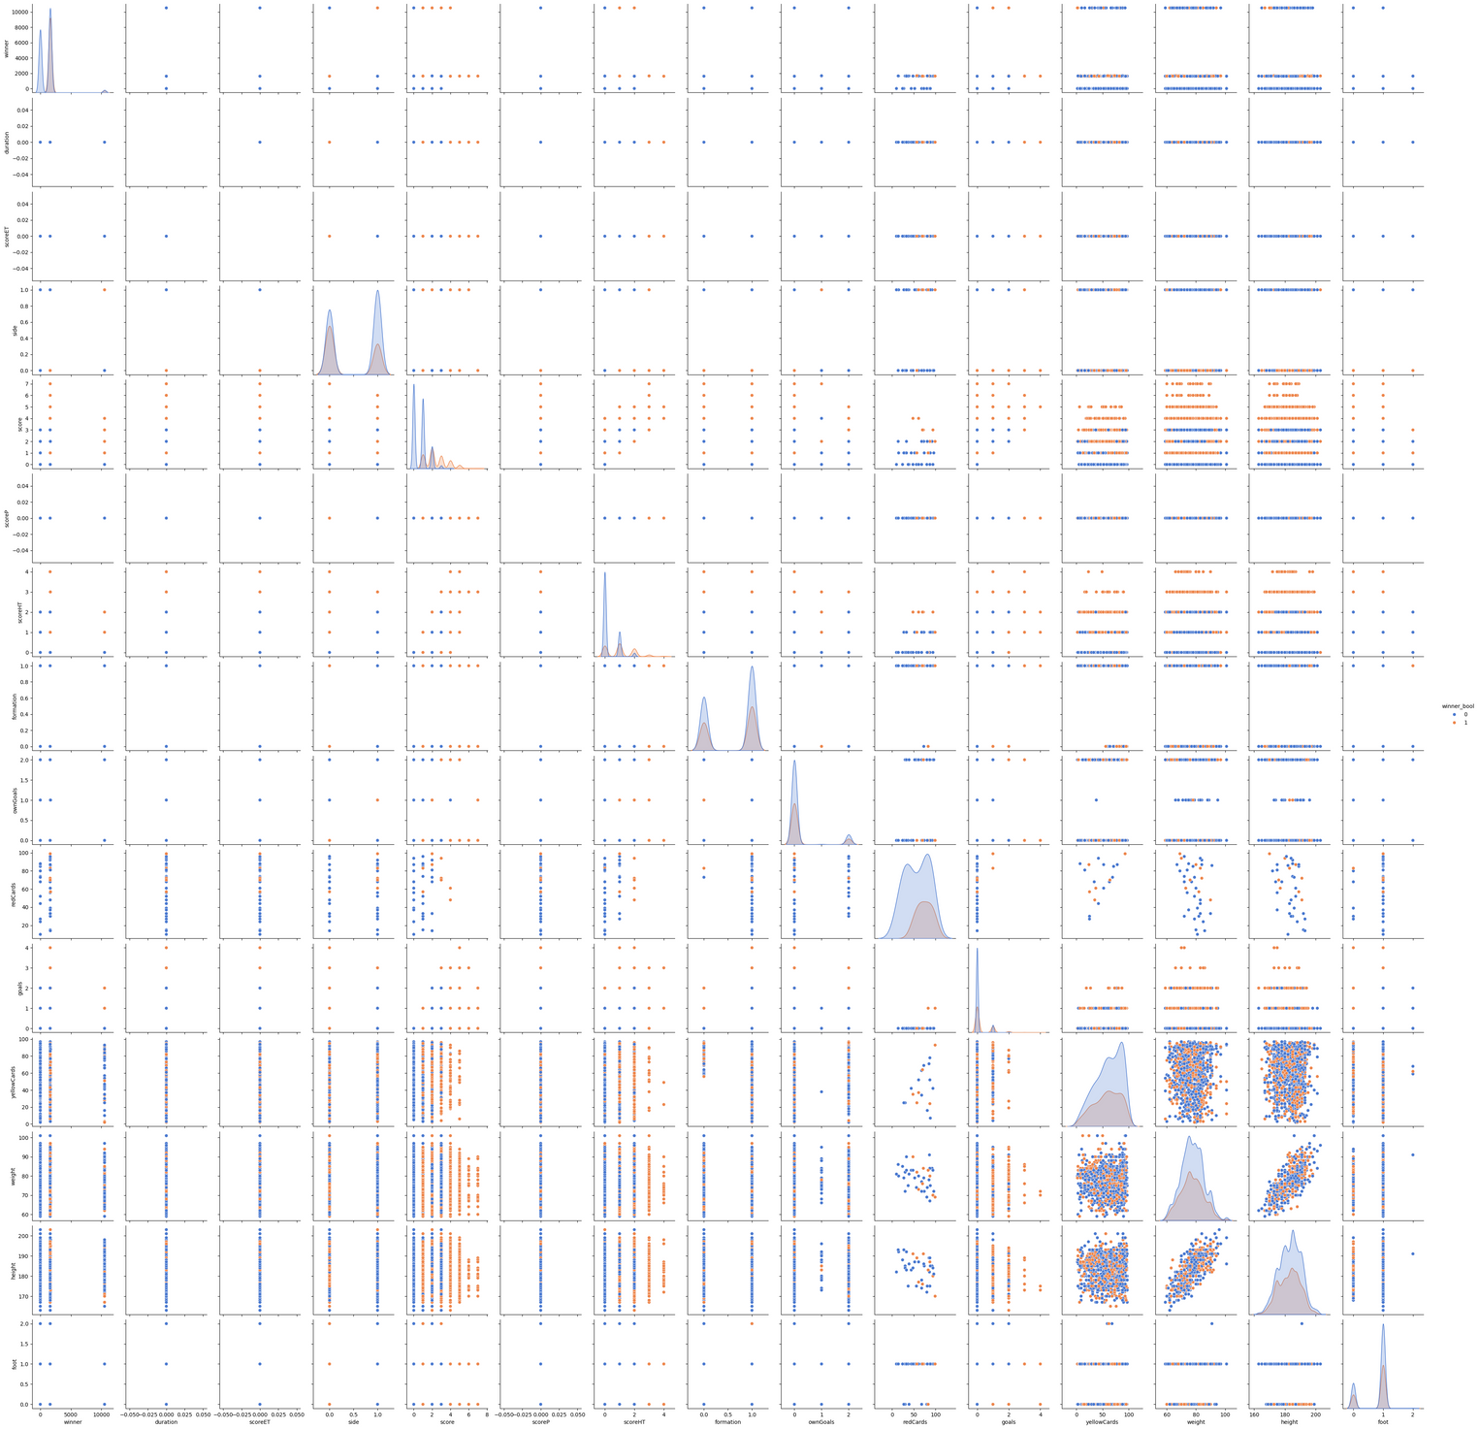
Notes:
Pair plot

Slide 11
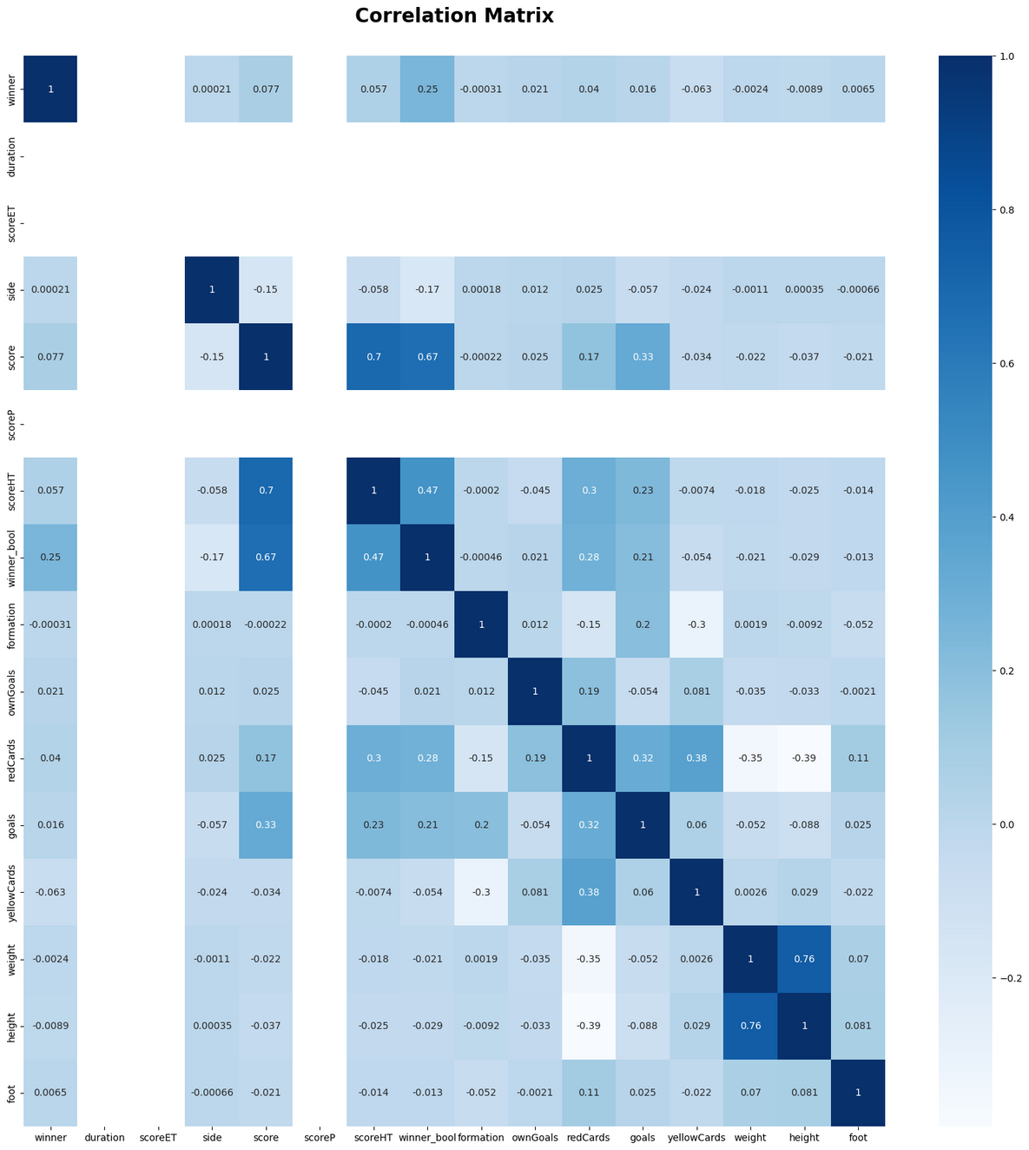
Notes:
Correlation metrix

Slide 12
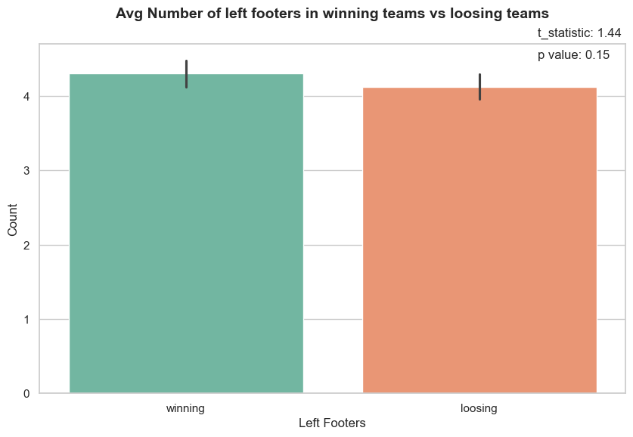
Fig: Average number of left footers in winning vs loosing team
Notes:
Winning - 4.3
Loosing - 4.12
T Statistic - 1.44
P Value - 0.15 ( Not Significant)

Slide 13
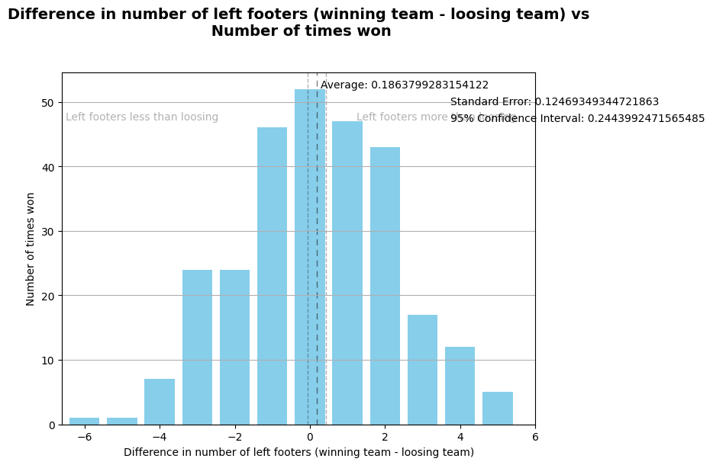
Fig: Distribution between left-footed players and winning
Notes:
Avg - 0.19
So with a 95% CI
-0.04 to 0.43

Slide 14
No of Left Footers | Wins | Winning Probability
0 | 0 | 0.0
1 | 9 | 0.375
2 | 28 | 0.358974
3 | 53 | 0.355705
4 | 65 | 0.338542
5 | 55 | 0.335366
6 | 44 | 0.435644
7 | 22 | 0.478261
8 | 3 | 0.6
Table: Winning probability with number of left foot players

Slide 15
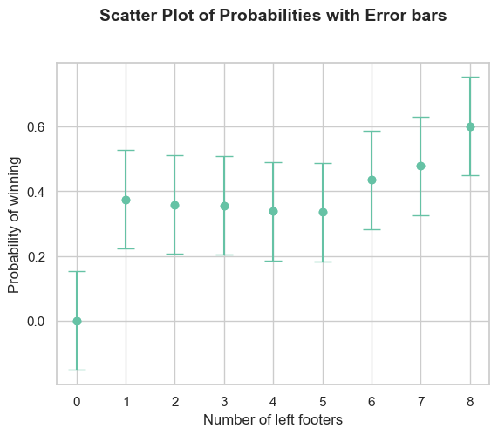
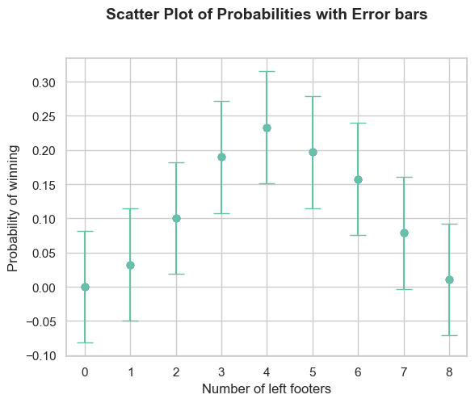
Fig: Scatter plot of winning proberbility with number of left-footed players

Slide 16
 | Winning | Loosing
Left footers | 1201 | 1149
right footers | 3807 | 3847
t- statistic score: 1.28
p-value: 0.20
Table: Contingency table, left & right footed players played matchup in winning and losing teams
Notes:
T-test
Contingency table

Slide 17
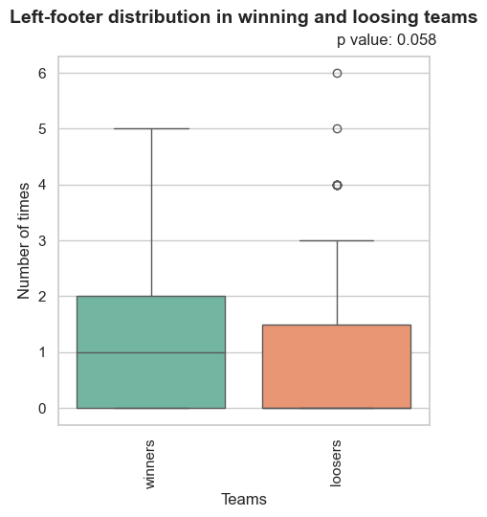
Fig: Distribution of left-footed players across winning and loosing
Notes:
We couldn't disprove the null hypothesis.
XX - The number of left-footed players does not impact the outcome of the match!

Slide 18
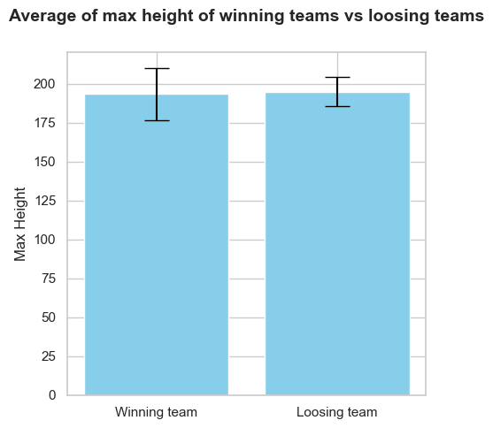
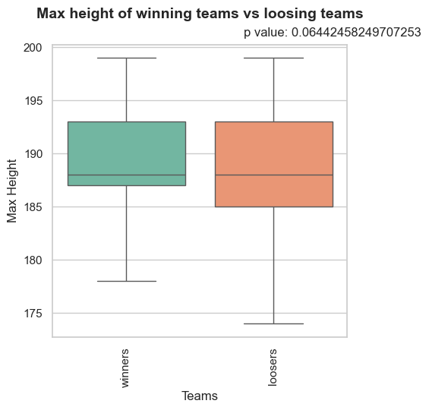
Fig: Footedness of the players in the tournament (England)

Slide 19
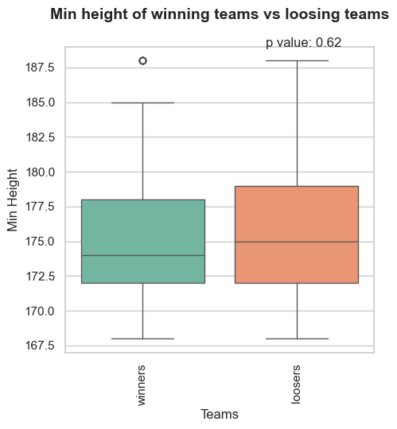
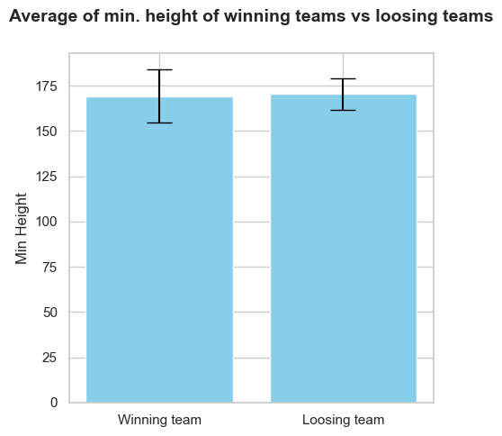
Fig: Footedness of the players in the tournament (England)

Slide 20
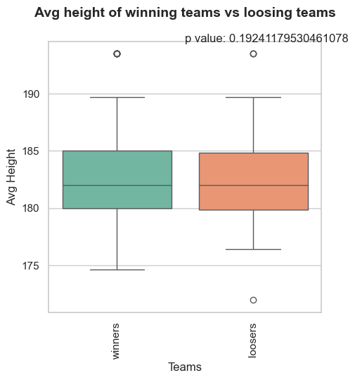
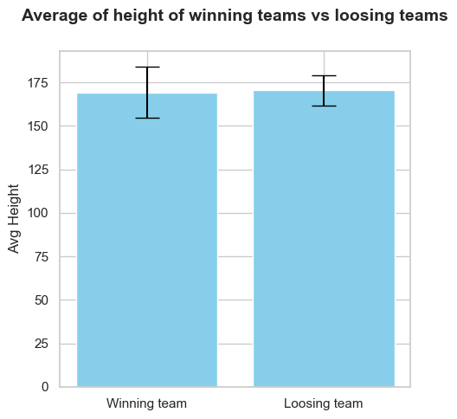
Fig: Footedness of the players in the tournament (England)

Slide 21
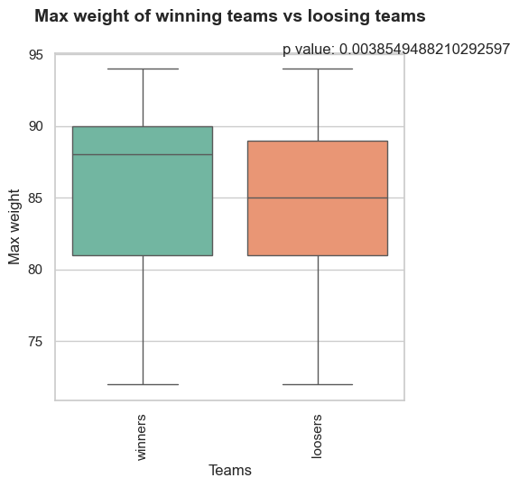
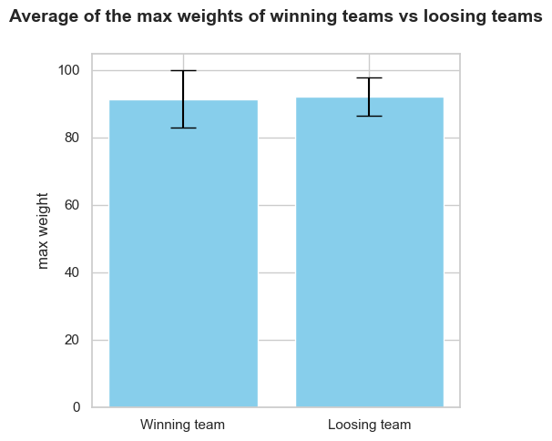
Fig: Footedness of the players in the tournament (England)
Notes:
P - 0.003

Slide 22
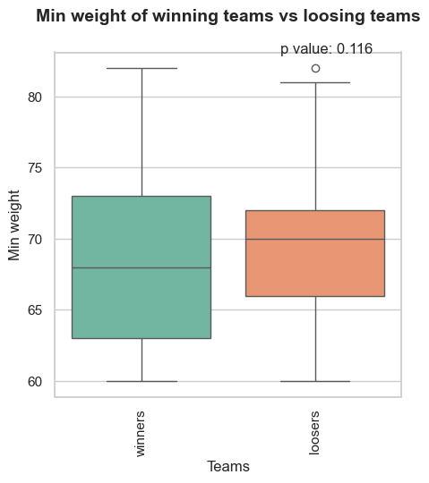
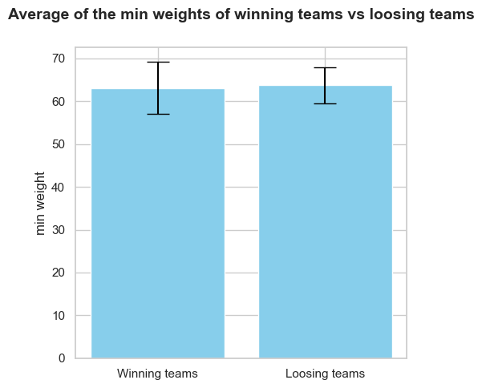
Fig: Footedness of the players in the tournament (England)

Slide 23
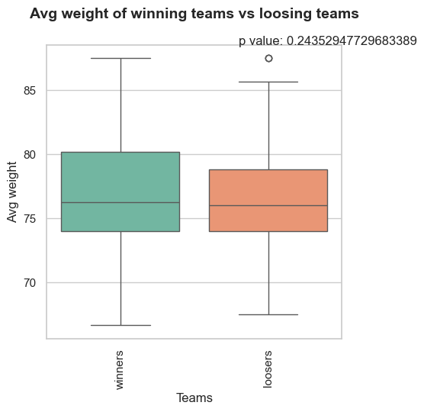
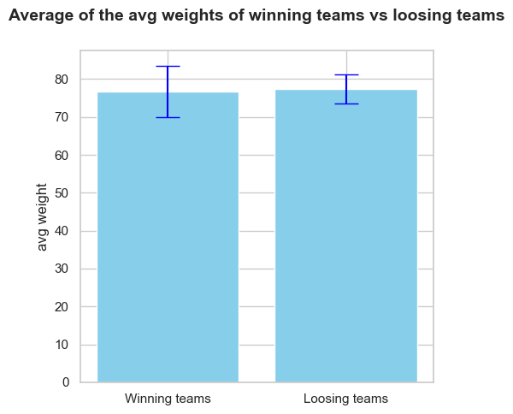
Fig: Footedness of the players in the tournament (England)

Slide 24




CONCLUSION & DISCUSSION
We were unable to disprove the null hypothesis that the number of left-footed players does not impact the outcome of the match!
We Couldn’t find any significant data to say there was an association between players' height and the outcome of the game.
There was a significant difference between the winning teams' heaviest players and the losing teams' heaviest players. This might be an interesting topic to explore

Slide 25
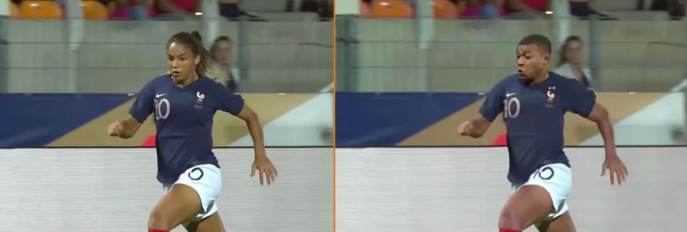

ASSUMPTIONS
Benched players were considered as if they were substituted into the match at some point.
Own goals were considered mistakes and not included in individual players' goals
Off to a Disappointing Start - Euro Sports - https://www.eurosport.fr

Slide 26
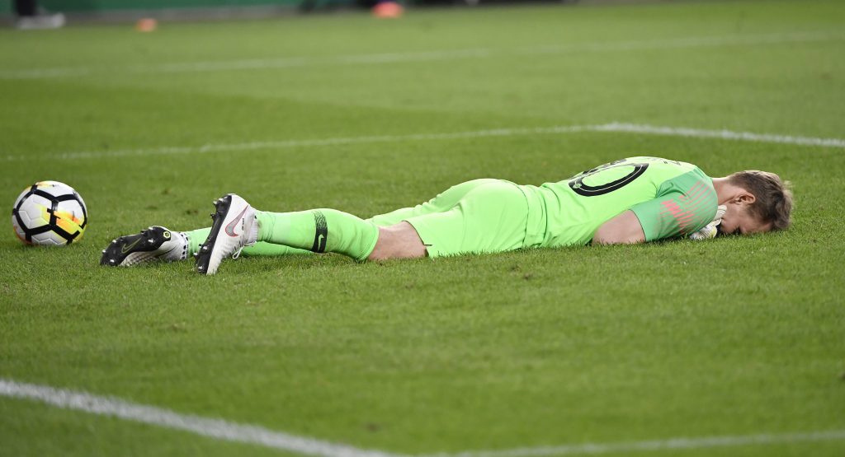
LIMITATIONS
Time in pitch for the players was not considered.
Matches/teams/players were analysed in respective tournaments, not as a whole.
Spatio-temporal data was not utilized.
Off to a Disappointing Start - Hungary Today - https://hungarytoday.hu

Slide 27

NEXT UP
Things that will be neat to try out
Use the Spatio-Temporal data to make a network model and analyse the resulting data
Take the playing time of each player into consideration when analysing the data
Explore the other tournaments, and take all of them as one and analyse the data.
STEP 3
STEP 1
STEP 2

Slide 28

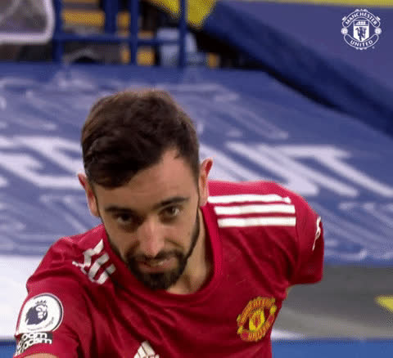
THANK YOU FOR LISTENING

